Slide 1
Beam Cooling

Slide 2
Beam Temperature
We define the beam temperature as:
The longitudinal temperature:
The transverse temperature
Notes:
\frac{1}{2}kT_\parallel=\frac{1}{2}mv_\parallel^2=\frac{1}{2}m \beta^2 c^2\left(\frac{dp}{p}\right)^2

Slide 3
Why beam is hot
The beam is generated at source. They have temperature from the distribution
Electron come from cathodes, with initial Fermi-Dirac distribution
Proton come from the plasma, with Maxwell-Boltzmann distribution
Later on the beam can be ‘heated’ due to mismatch, intra-beam scattering, residue gas, etc.

Slide 4
What is beam cooling
Cooling is to reduce the phase space area of the beam or the temperature of the beam, or maintain the emittance against the factors to make emittance growth.
We already learn ways to reduce emittance which are not cooling methods:
Acceleration
Collimation

Slide 5
Way of Cooling
Synchrotron Radiation
Ionization Cooling
Electron Cooling
Stochastic Cooling
Coherent electron cooling

Slide 6
Electron does not need cooling:
Synchrotron Radiation is a natural way of cooling (damping).
Revisit the energy deviation motion:

Slide 7
Synchrotron Radiation
With the damping force that is proportional to the velocity, this is not a Hamiltonian system anymore.
SR is also bring large heating effect and balance out its damping effect, as we learned earlier.
Notes:
\Delta E\sim \exp{\left(\pm\sqrt{\alpha_E^2-\omega^2}-\alpha_E\right)t}

Slide 8
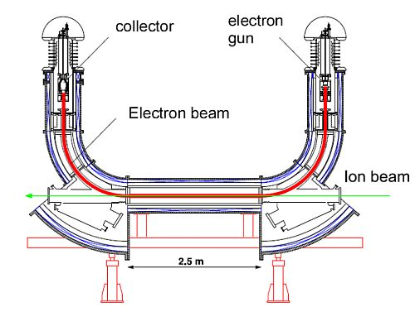
Electron Cooling
Cold electron interact with hot ion beam via Coulomb interaction.
Longitudinal temperature: ~1e-4eV
Transverse temperature:~0.1eV
G. Budker

Slide 9
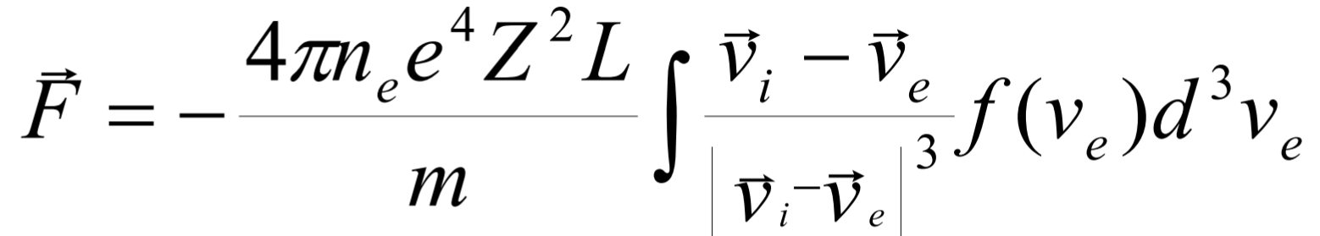
Electron Cooling II
In the electron beam velocity reference frame:
E-beam
E-beam
Faster ions
Slower ions
Maximum cooling force
For small relative velocity
For large relative velocity

Slide 10
Electron Cooling III
The cooling time:
Therefore the electron cooling is good for:
Cold beam
Low energy beam
Dense electron beam
Highly charge beam
Does not matter on the intensity of the ion beam.

Slide 11
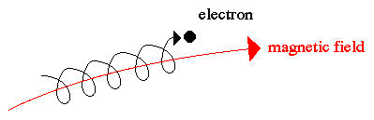
Electron Cooling IV
Electron is usually confined in longitudinal magnetic field. (Magnetized cooling)
All electrons experience cyclotron motion.
Interaction time >> cyclotron period, the transverse temperature is not important, only depend on longitudinal temperature.

Slide 12
Electron Cooling Example: LEReC @ BNL
First demonstration of electron cooling using RF accelerated electron beam.
For the low-energy RHIC run for searching QCD critical point.
Long proton (~30 ns) vs. short electron, RF frequency 704 MHz.
Solution: Micro bunch trains.

Slide 13
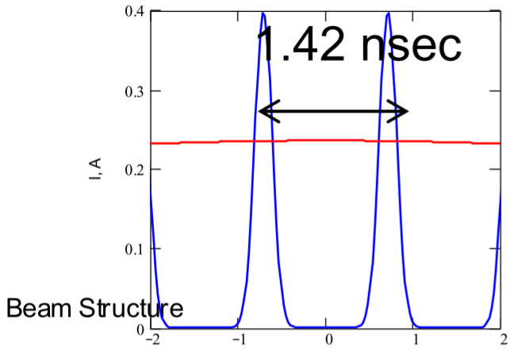
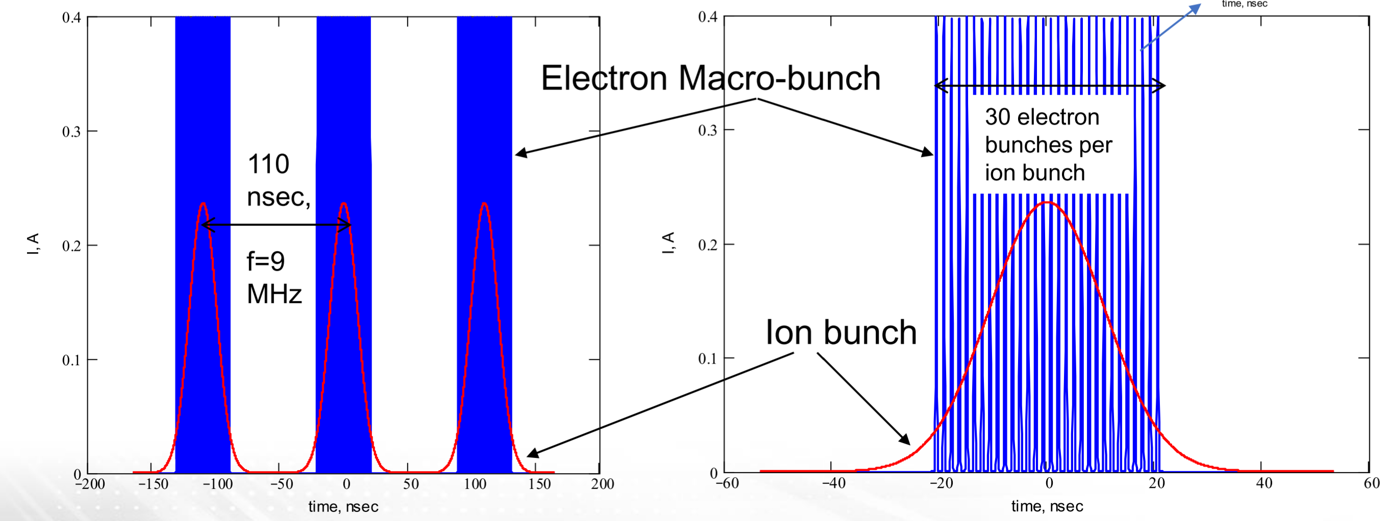
E-Cooling: LEReC, bunch trains
30 ‘micro’ electron bunch trains for one proton bunch.
 | Ion | Electron
Bunch charge | 5e8 Ions | 6.3e8 (100pC)
Bunch length | ~3m | ~3cm
@ A. Fedotov

Slide 14
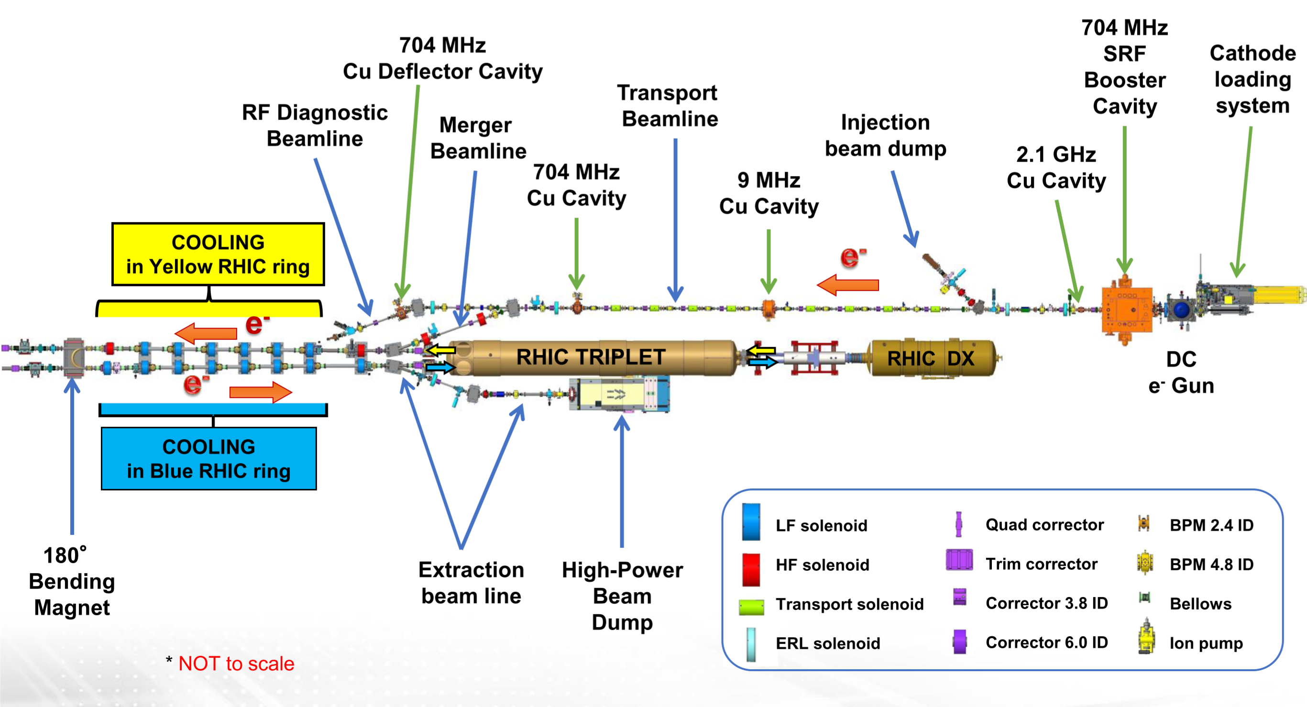
E-Cooling: LEReC, setup
@ A. Fedotov

Slide 15
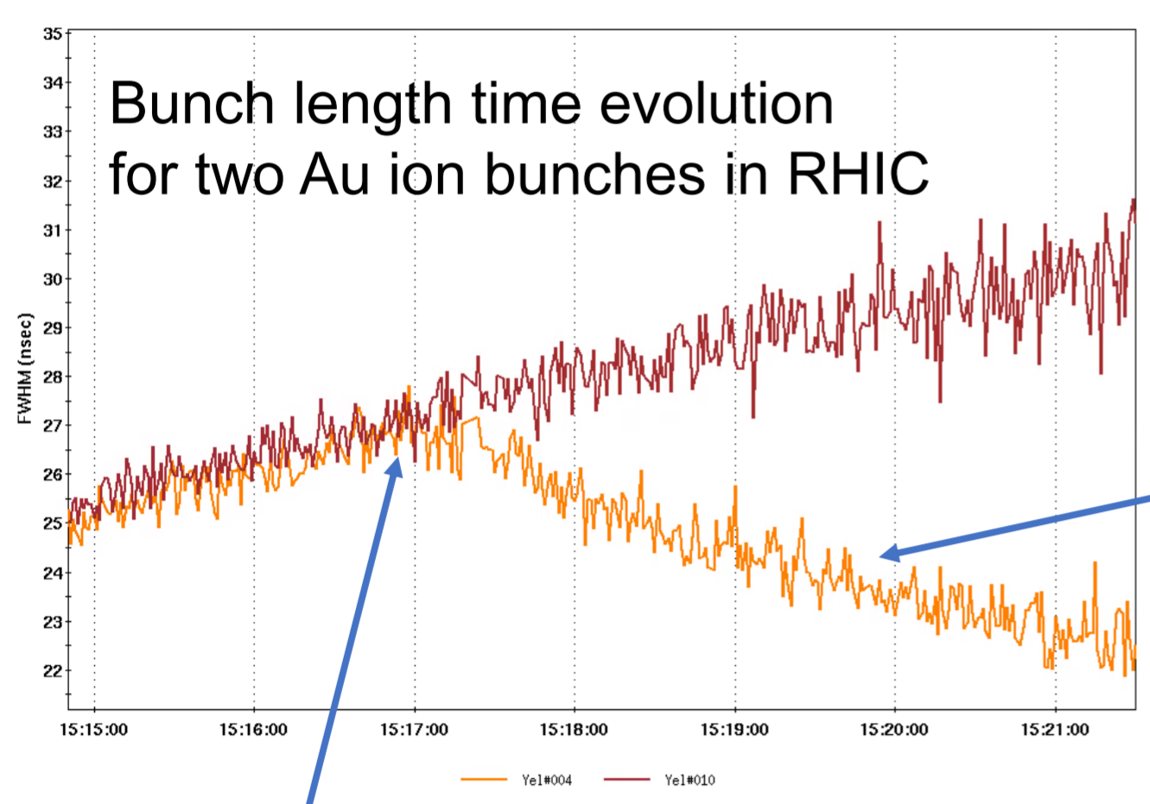
E-Cooling: LEReC, Observation
Witness bunch
Bunch being cooled.
Electron and ion are well matched.
@ A. Fedotov

Slide 16
Ionization Cooling
Muon collider needs much shorter cooing time, since they decay in 2.2 micro seconds.

Slide 17
Ionization Cooling II
As we noticed, this is naturally a transverse process, we can use dispersive region to make it also work in longitudinal plane.

Slide 18
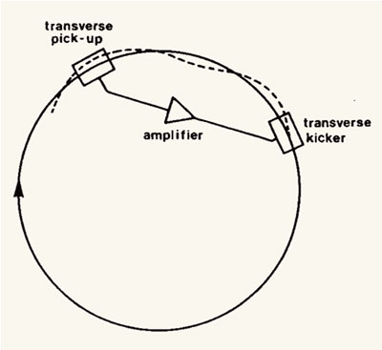
Stochastic cooling
First brought up and realized in CERN by Simon van der Veer.
Nobel Laureate.
A negative feedback system for individual particles’ signal.
(N+0.5) pi phase advance between pickup and kicker

Slide 19
For individual particle

Slide 20
Bandwidth Rules
Requires infinite bandwidth
For a finite bandwidth W, the signal is averaged in time window of 1/2W.

Slide 21
Mixing
Without cooling, the cooling process will stop after the first iteration.
Good mixing:
kicker to pickup
Bad mixing:
pickup to kicker

Slide 22
Stochastic Cooling at RHIC
Kicker Cavity

Slide 23
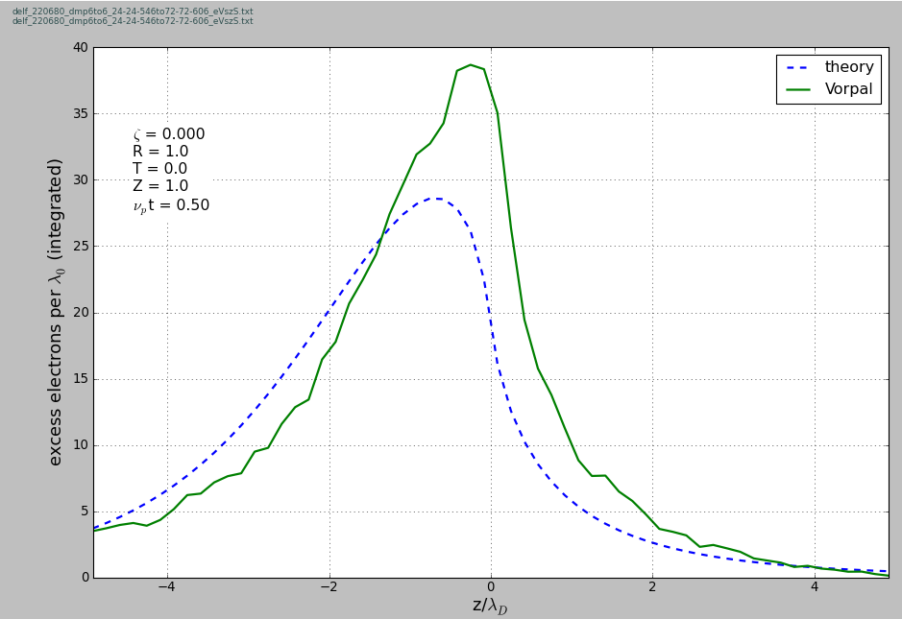
Bandwidth Improvement Coherent Electron Cooling
Bandwidth determined by FEL, also good fore high energy
E < E_{h}
E_{h}
E < E_{h}
Dispersion section
( for hadrons)
E > E_{h}
E_{h}
λ
Hadrons
Modulator
E > E_{h}
Kicker
l₁
High gain FEL (for electrons)
l₂
Electrons
i
v_{i}
v_{e}

Slide 24
CEC II

